Slide 1
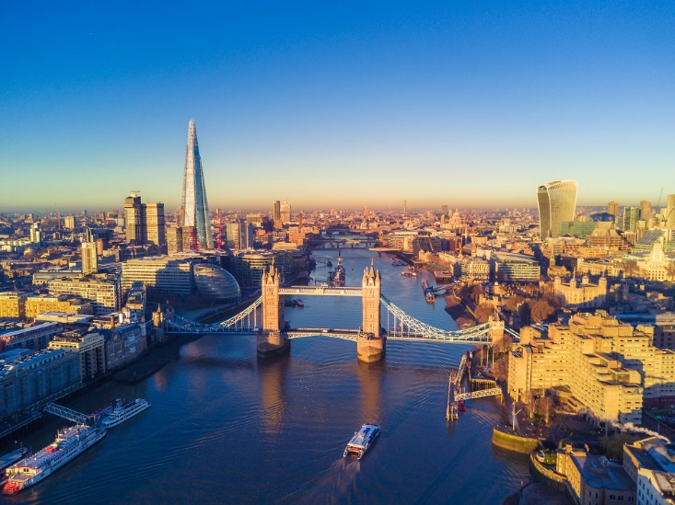

St Breock Primary School
trip to London
29th June - 1st July 2022

Slide 2
Agenda
About WST Travel
Trip Overview
Accommodation Info
Questions

Slide 3






Fully established,
providing school travel for over 35 years
Fully accredited with all trade body licenses.
Staff have around 400 years of combined
School travel experience.
The ONLY school tour operator with a Government
Standard Excellence Award and proud winner of Best School Tour Operator for 4 years running!

Slide 4
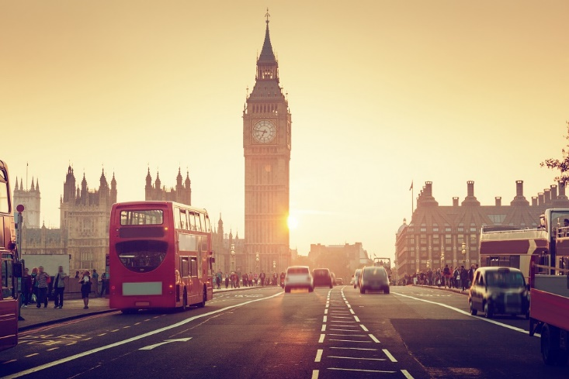
Trip Overview
Staying at The Premier Inn London
Heathrow Terminal 4
Visits:
Natural History Museum
Imperial War Museum
Time permitting – Science Museum
London Eye
Thames River Cruise
Harry Potter World
Evening Performance of Wicked
the musical

Slide 5

Visit also to include -
* Two evening meals in popular London
Restaurants such as Pizza Express
* Packed Lunches provided for day 2 and
day 3
* Coach Travel throughout to and from
school
* Fully protected travel insurance with
AXA Insurance

Slide 6
PREMIER INN LONDON HEATHROW
The hotel is located at Heathrow . It is one of our most popular hotels used by school groups
Hotel Facilities -
Buffet breakfast served between 5:30 and 10:00 hours
Lifts
Coach Parking opposite the hotel
24 hour reception
2 and 3 bedded rooms for students
All single beds
All en-suite facilities
All rooms have hairdryer and TV

Slide 7
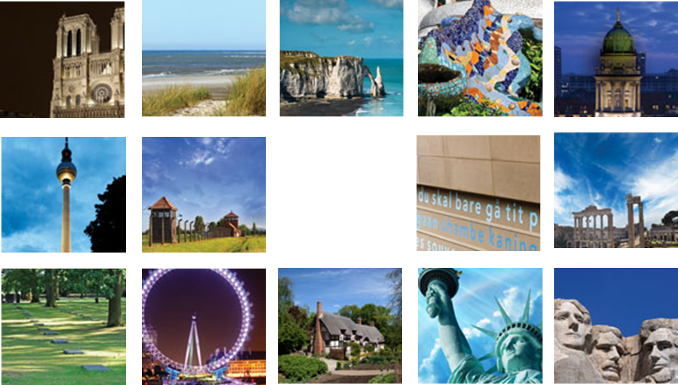
Paris
Opal Coast
Normandy
Catalonia
Rhine &
Moselle
Berlin
Krakow
Amsterdam
Rome
WW1
Ypres &
Somme
London
Stratford
New York
Washington
www.wsttravel.com

